Slide 1
When to buy a used car?

Slide 2
Introduction:
The aim of the project is to evaluate used car prices and study the pattern to identify the best time to buy a used car
A car being a depreciating asset usually losses its market value with factors like time and mileage contributing to its decline
Typically used car listing provide brand, mileage, model, colour and technical specifications about a car
Prospective client: Any individual researching for buying a used car. Insights can be hosted on a blog or website with a link to dashboard that allows user to explore different card brands
Dataset overview:
Data for the project is scrapped from eBay’s used car listings
Data Source="https://www.ebay.com/sch/Cars-Trucks/6001/i.html?&LH_ItemCondition=2|0&_trksid=p2050890.m1603"
Data set details: Scrapped dataset contains used car listing for 223,517 cars

Slide 3
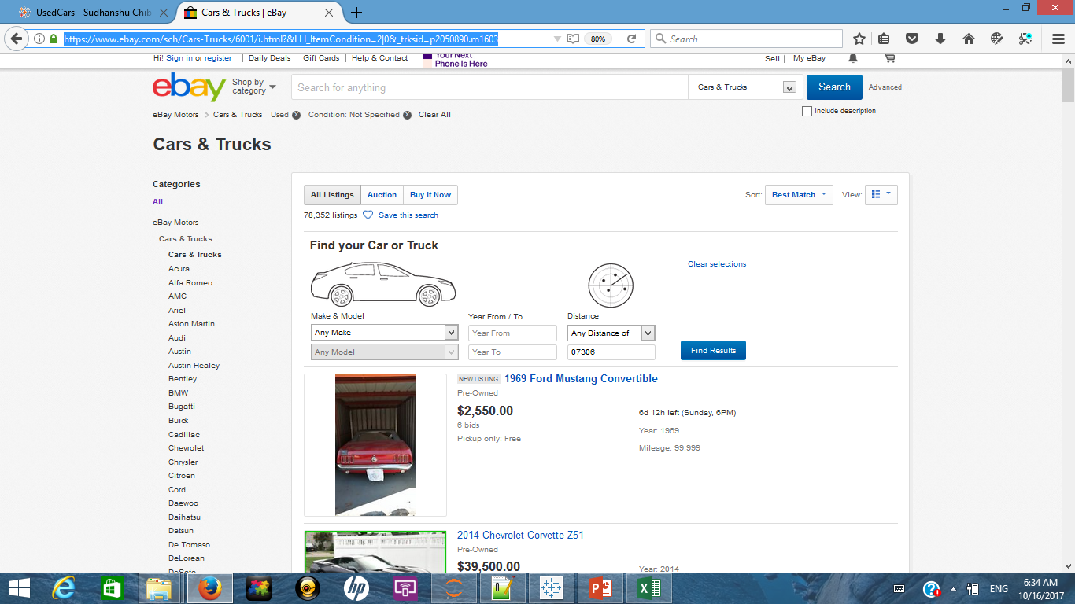
Methodology: Capturing Data
A combination of python libraries Requests and Beautiful Soup is used to scrape data from eBay
On the home page car brand categories are captured and stored as a list
For each list entry (car brand), redirection URL for the car brand is also stored

Slide 4
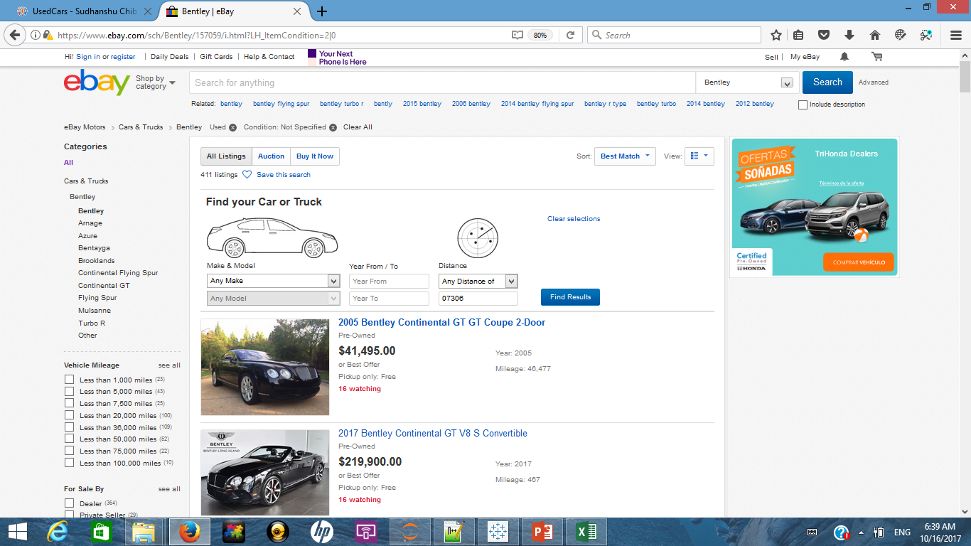
Methodology: Capturing Data
On each redirected brand page, all listed car entries are looped through information like car name, listed price, mileage and year of manufacture are captured
Car information is processed to capture to identify car model
For a given brand all available car listings across multiple pages are captured
IMP: eBay limits the user to a 10,000 results per query criteria. Hence data was captured by looping through brand type.

Slide 5
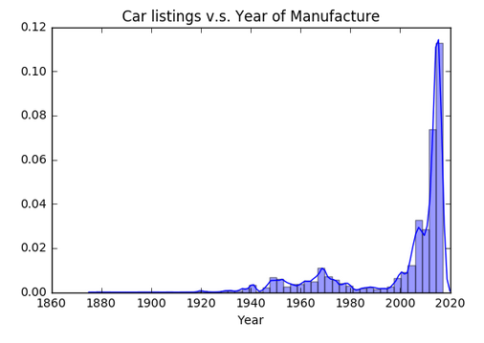
Methodology: Processing and Evaluating Data
Logically incorrect and extreme values were removed from the data set using the below mentioned rules
Removing car listings where "On Road Year" < 0, Cars listed as 2018 or beyond(probable misprint).
Removing car listings where "Price" > 200,000, Outliers.
Removing car listings where "Mileage" > 500,000, Outliers.
Post removal of outliers, the data set had 233,827 cars where an average listing was priced at $38,762 and had run 43,784 miles
Breakup of car listings across the years is shown below:
Most of the used cars available on eBay were manufactured in the last 10 years.
There seems to be some peaks around late 1960’s and early 1970’s car listings too

Slide 6
Methodology: Processing and Evaluating Data
Data like “Number of Years on Road” and “Mileage” was binned or categorised into ranges of
# of years on road: "LessThan2yrs","2To5yrs","5To10yrs","10To15yrs","15To20yrs","20To50yrs","Heritage“(>50yrs)
Mileage: "LessThan5K miles","5To10K miles","10To20K miles","20To30K miles","30To50K miles","50To75K miles","75To100K miles","100To150K miles","150To300K miles","Roundown“ (>300K miles)
Cut-off values are determined by plotting and evaluating histograms of data at different cut off values
Another categorical variable was created based on values of “Number of Years on Road” with cut-off at 15 yrs. Cars with value less than 15yrs were tagged as “Contemporary” and older cars were tagged as “Collectable”
Car listing that did not belong to top 86 brand categories were removed from the dataset. These were cars that did not follow naming convention hence were difficult to map with their respective brands.

Slide 7
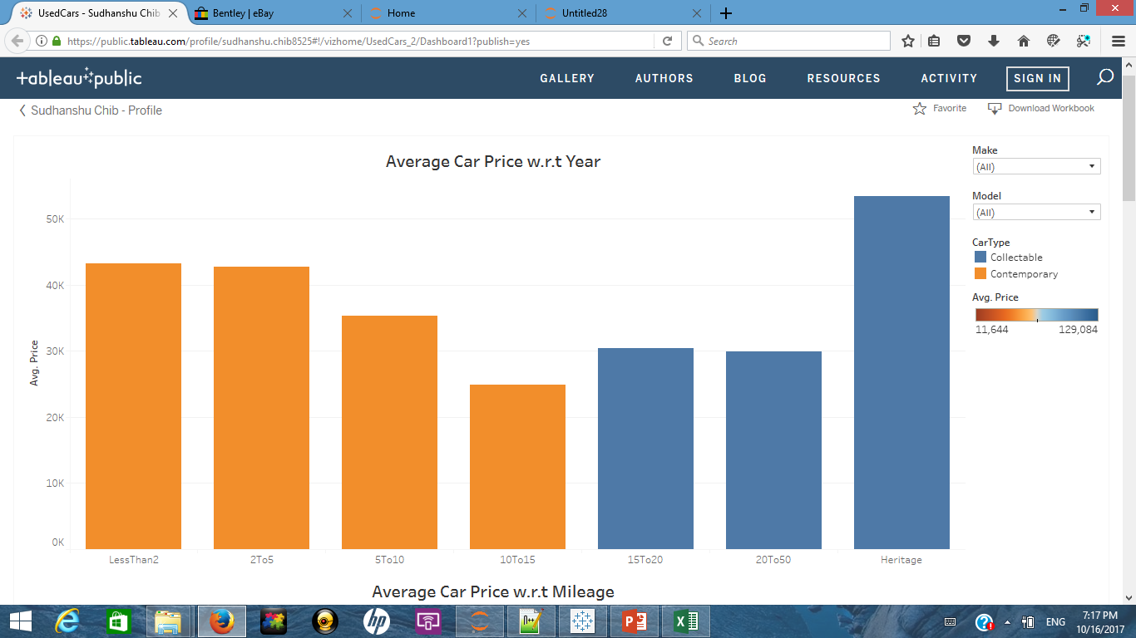

Observations and Insights:
LINK
Generally the price of a car decreases over a period of time (10-15 yrs)
Some car brands appreciate in value post 15 to 20 yrs
So a buyer looking to buy a used car for commute would look to buy a car brand that depreciates the least in the first 10-15 yrs
Whereas a buyer looking at a collectable car might want to invest in a brand that historically appreciates the most

Slide 8
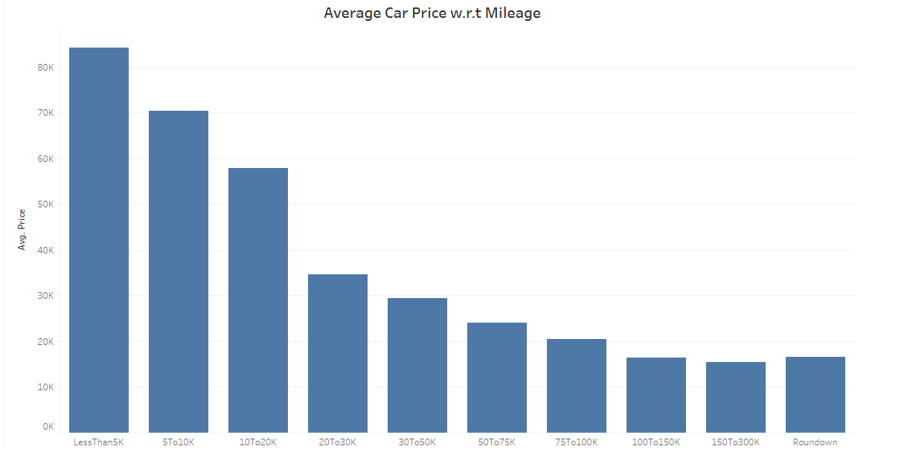
Observations and Insights:
Average Price commanded by cars tends to decrease as number of on road miles increases

Slide 9
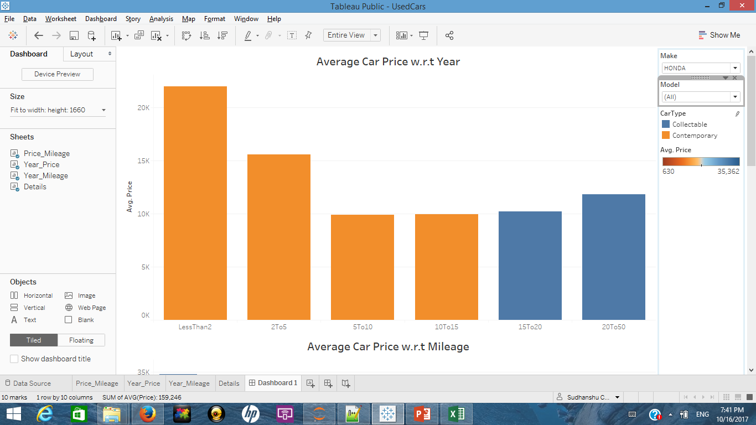
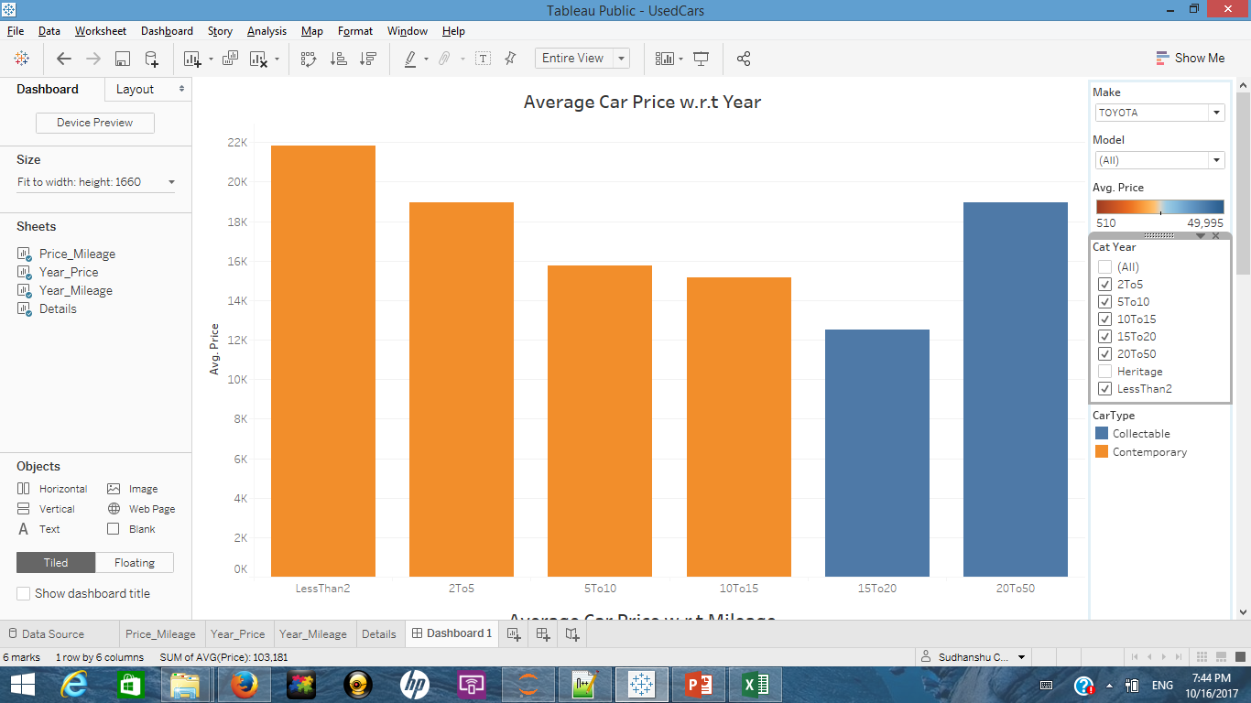
Observations and Insights: Brand Comparison for Honda and Toyota
Honda
Toyota
Cars from Honda tend to depreciate in value at a greater rate than Toyota in the initial 15 yrs
Best time to buy both the car brands is 5 to 10 yr old car (2012-2007 model)

Slide 10
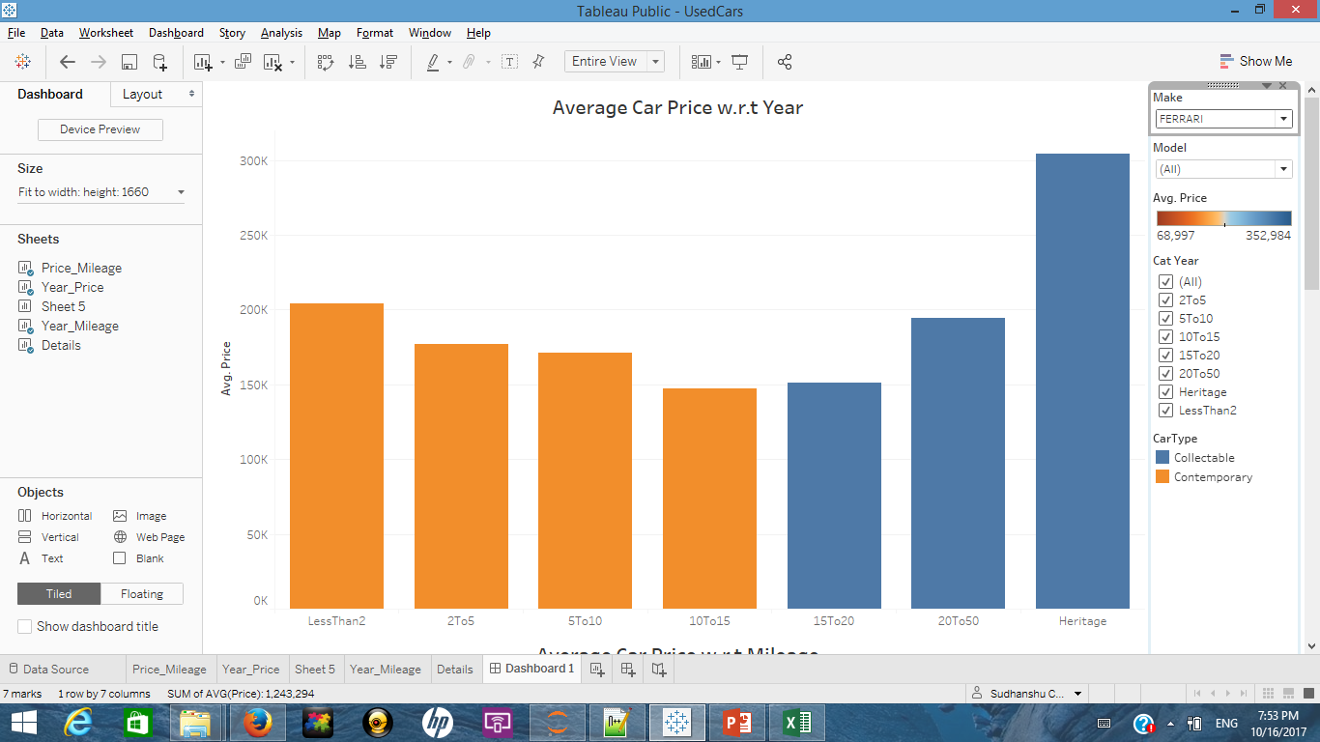
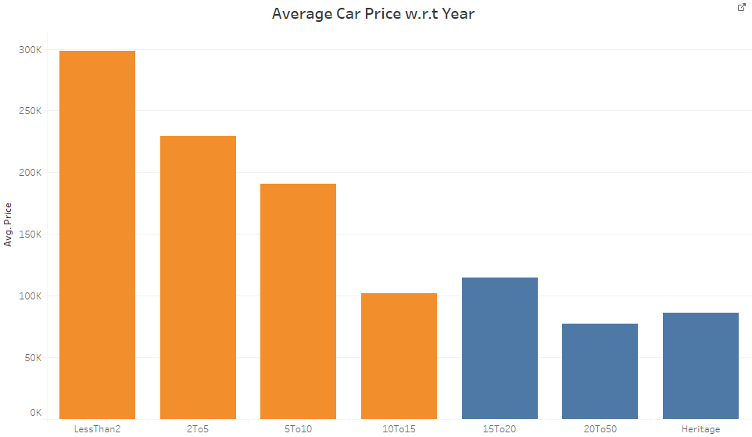
Observations and Insights: Brand Comparison for Ferrari and Rolls-Royce
Ferrari
Rolls-Royce
Ferrari as a brand depreciates less as compared to Rolls-Royce and some models have high collectable value.
Rolls-Royce on the other hand depreciates more and older models have little collectable value.

Slide 11
Key takeaways:
Used car values tend to decline rapidly over the first 10 yrs
Mileage has negative effect on car’s value
Best time to buy a used car is typically 5-10 yrs from the year of manufacture
Value of different car brands depreciates differently over time

